Slide 1
Gait Deviations
Dr. Sanket Mungikar
Dept Of Musculoskeletal Physiotherapy
MGM Institute Of Physiotherapy
Chh.Sambhajinagar

Slide 2
Abnormal gait
Abnormal gait or gait deviations occurs because of three reasons :
1.Pathology or injury in specific joint .
2.Compensation for injury and pathology .
3.Finally occurs as compensation injury or pathology on opposite side ,
Abnormal Gaits :
1.Antalgic gait .
2.Arthrogenic gait .
3.Ataxic gait.
4.Contracture gait.
5.Equinus gait .
6.Gluteus maximus gait.
7.Gluteus medius gait .
8.Hemiplegic gait .
9.Parkinsons gait .
10.Drop foot gait.
11.Scissors gait .
12.Quariceps avoidance gait.

Slide 3
Antalgic gait :
It is self protective and because of injury to the Pelvic and Knee,Ankle ,the stance phase on affected leg is shorter than non affected leg.and the swing phase of uninvolved leg is decreased .result in shorter step length on uninvolved side ,decreased walking velocity and cadence .
Arthrogenic gait :
This gait results from stiffness or laxity or deformity may be painful or pain free .if the knees or hip is fused ,the pelvis may be elevated by exaggerated planter flexion of opposite ankle and circumduction of stiff leg to provide toe clearance.the patient with this gait lifts entire leg than normal for ground clearance .
Ataxic gait :
If the patient has poor sensation or lack muscle coordination ,there is tendency towards poor balance and broad base .gait of cerebellar Ataxia patients includes lurch or stagger ,all movements are exaggerated .their foot slap the ground .patient watches foot while walking ,resulting gait is irregular and jerky.
Contracture gait :
Joints shows contracture after prolonged immobilization due to injury or pathology ,hipflexion contracture shows increased lordosis of lumbar spine and extension of trunk combined with knee flexion to get the foot on ground .with knee flexion contracture patients shows excessive ankle dorsiflexion .if ankle joint is stiff then there is hyperextension of knee with forward bending of trunk with hip flexion .

Slide 4
Equinus gait :
Club foot basically weight bearing is on lateral edge of foot,depending upon deformity and weight bearing on affected side is reduced ,limp is present ,pelvic and hip are externally rotated .
Gluteus maximus:
It is primary hip extensor if it is weak the patient thrust the thorax posteriorly at initial contact to maintain hip in extension leads to backward lurch of the trunk.
Gluteus medius :
If these muscles are weak leads to lost in stabilization effect during stance phase .positive sign indicated contralateral pelvic drop because ipsilateral hip abductors do not stabilize if both sides are weak then called as wobbling gait .
Hemiplegic gait :
It shows sewing of hemiplegic gait (circumduction).
Parkinsons gait :
The neck ,trunk and knees of these patients are flexed ,and shows shuffling or short rapids steps ,arms are stiff patient may walk fast and called as fastination .
Scissors gait :
It is seen in spastic paralysis of hip adductors leads to knees draws together and legs swung forward with great difficulty.called as spastic gait

Slide 5
Quadriceps avoidance gait :
If quadriceps muscle is weak or injuried (femoral nerve neuropathy ,reflex inhibitation)then patients compensates intrunk and lowerlimb .forward flexion of the trunk and strong ankle plantar flexion causes extension of knee.
Drop foot gait :
There is weakness or paralyzed dorsiflexors resulting in drop foot .toavoid dragging of toes on ground patients lifts knee higher than normal .

Slide 8
Quadriceps weakness gait

Slide 9
Equinus gait

Slide 10
Gluteus Medius weakness gait

Slide 11
Parkinson's gait

Slide 12
Hemiplegic gait

Slide 13
Contracture gait

Slide 14
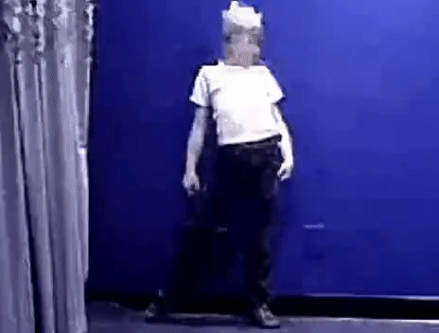
Gluteus maximus gait

Slide 15
THANK YOU

